Slide 1
DelCarte Property
Invasive Species Removal Update
Conservation Commission Presentation
April 28, 2022
Department of Planning & Community Development

Slide 2
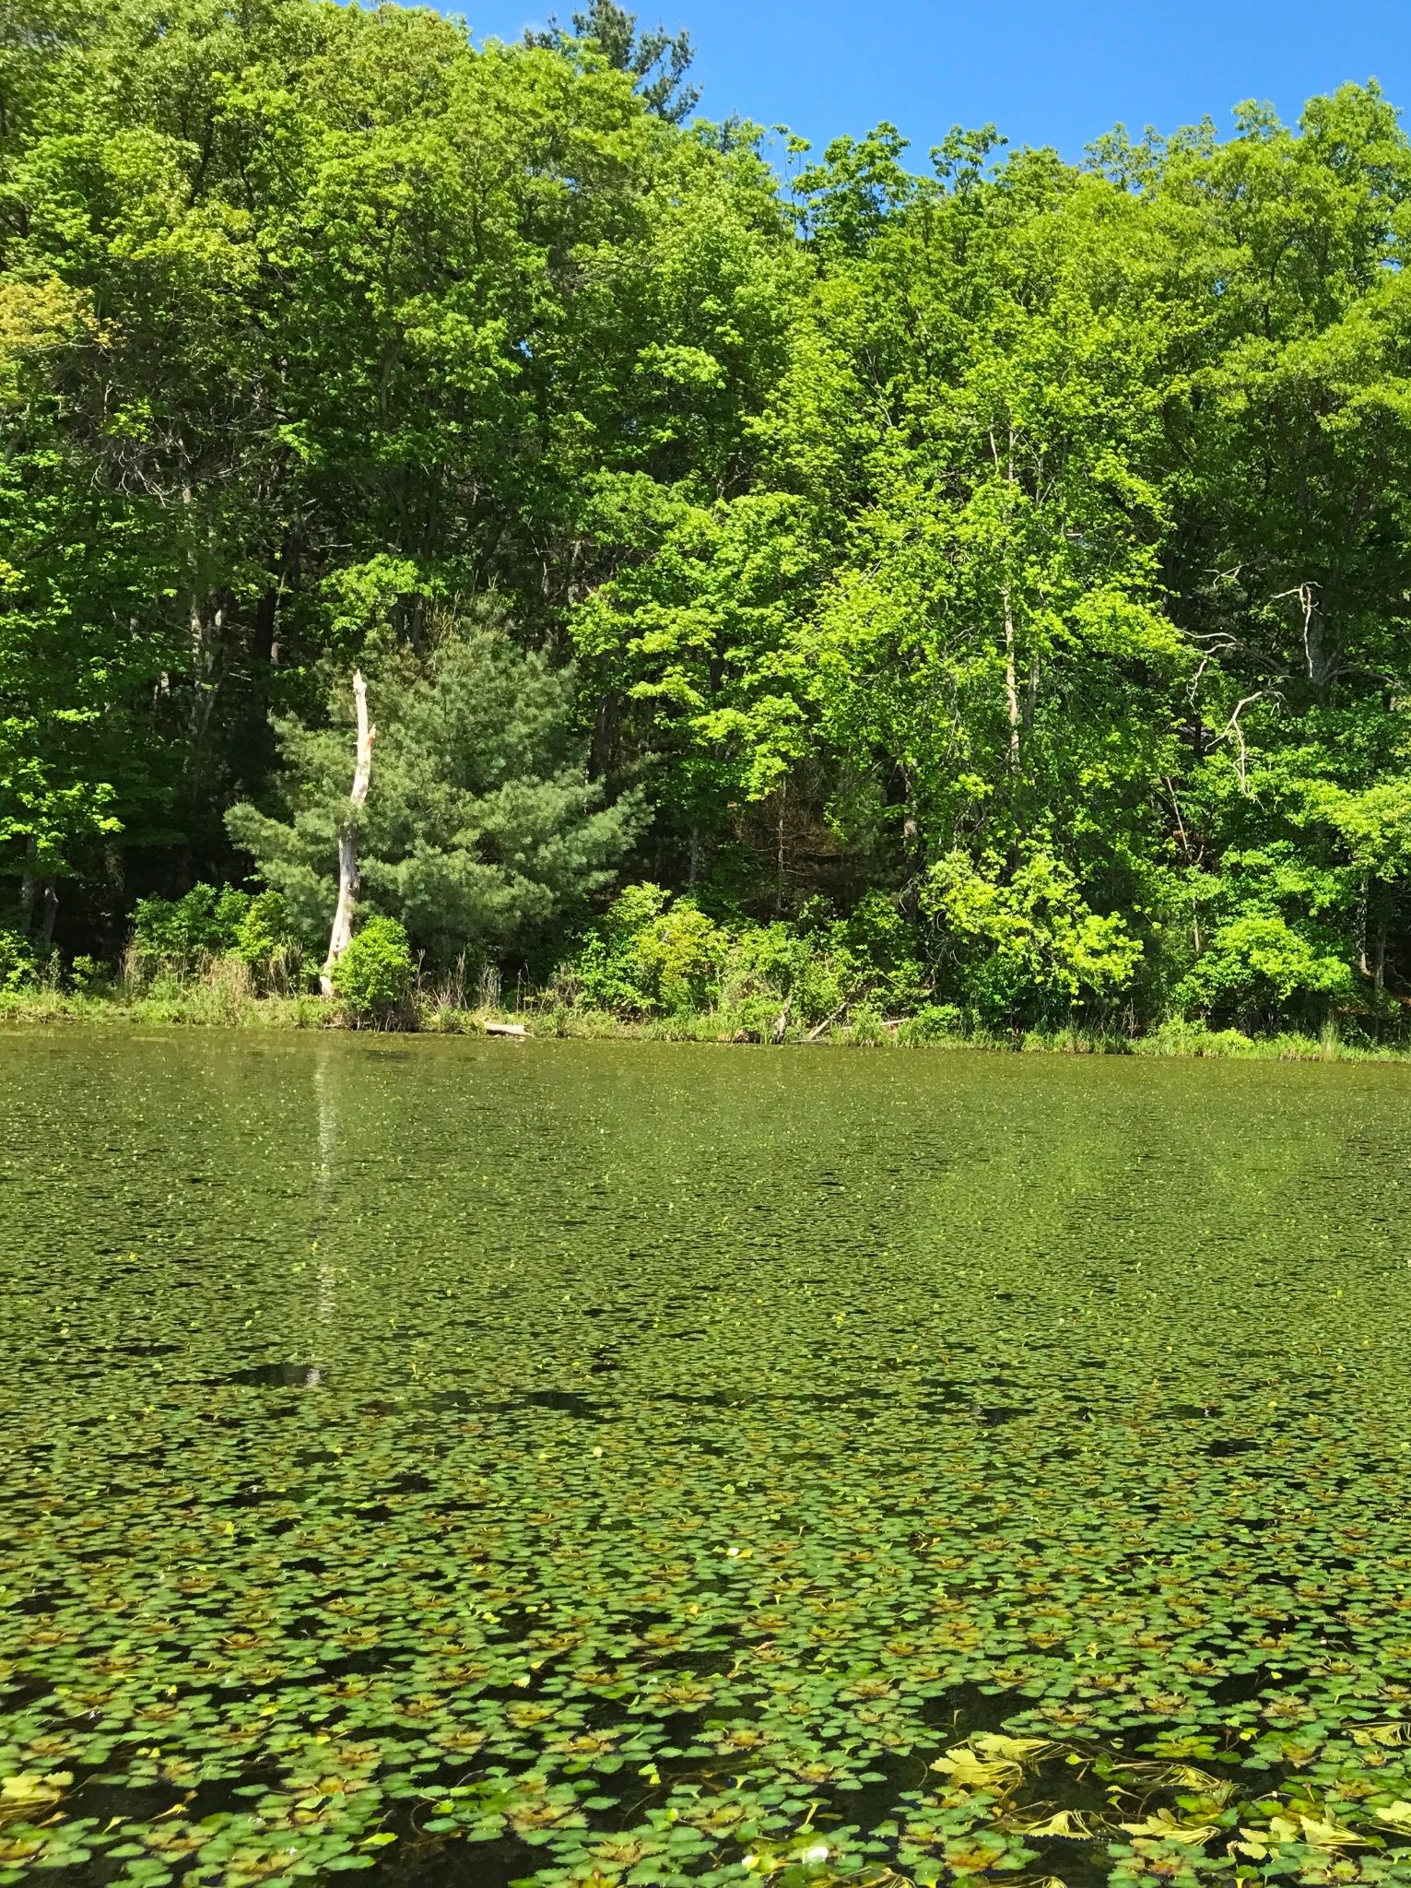
A Little Background
In 2015 the Town contracted with ESS Group to develop an Ecological and Management Study of the DelCarte Ponds.
The Study contains several recommendations related to the management of natural resources at the DelCarte Property, including ways to control two invasive species in Ponds 3 & 4.
June 2017

Slide 3
Background (Continued)
The Town contracted with Solitude Lake Management for chemical treatments with the goal of eradicating the two invasive species.
Contract includes permitting, posting of the treatments, treatment of the two plants, surveys & reporting.
Each year typically consists of 2-3 rounds of treatment, 3-4 rounds of monitoring, and a report.
We recently finished our fifth year of treatments.

Slide 4
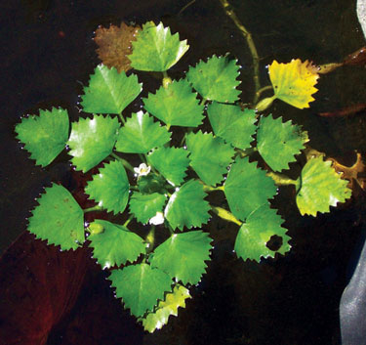
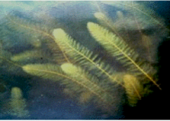
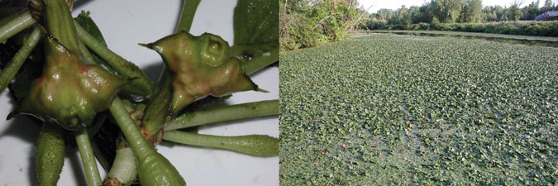
Invasive Species Targeted
https://www.invasive.org/alien/pubs/midatlantic/trna.htm#:~:text=Trapa%20natans%20L.&text=Water%20chestnut%20was%20first%20observed,prohibited%20in%20most%20southern%20states.
Water Chestnut
Variable Milfoil

Slide 5
Reasons to Control
these Invasive Species?
Impacts & Threats Posed
Total water surface coverage limits light for aquatic ecosystems
Limits oxygen levels leading to fish kills
Limits native vegetation growth
Impairs recreational activities such as boating & swimming
http://macolap.org/wp-content/uploads/2015/11/MA-DCR-Variable-Milfoil.pdf

Slide 6
Chemicals
Clearcast has been used for Water Chestnut.
Diquat has been used for Variable Milfoil.
Changes to Water Chestnut Treatment in 2021
Addition of Clipper (Flumioxazin) to aid the uptake of Clearcast.
The goal is to have the Clearcast absorbed faster before the plant has a chance to drop any seeds.
Seeds can be dormant for 10-12 years.
Note: Flumioxazin is also a fast acting herbicide on contact.

Slide 7
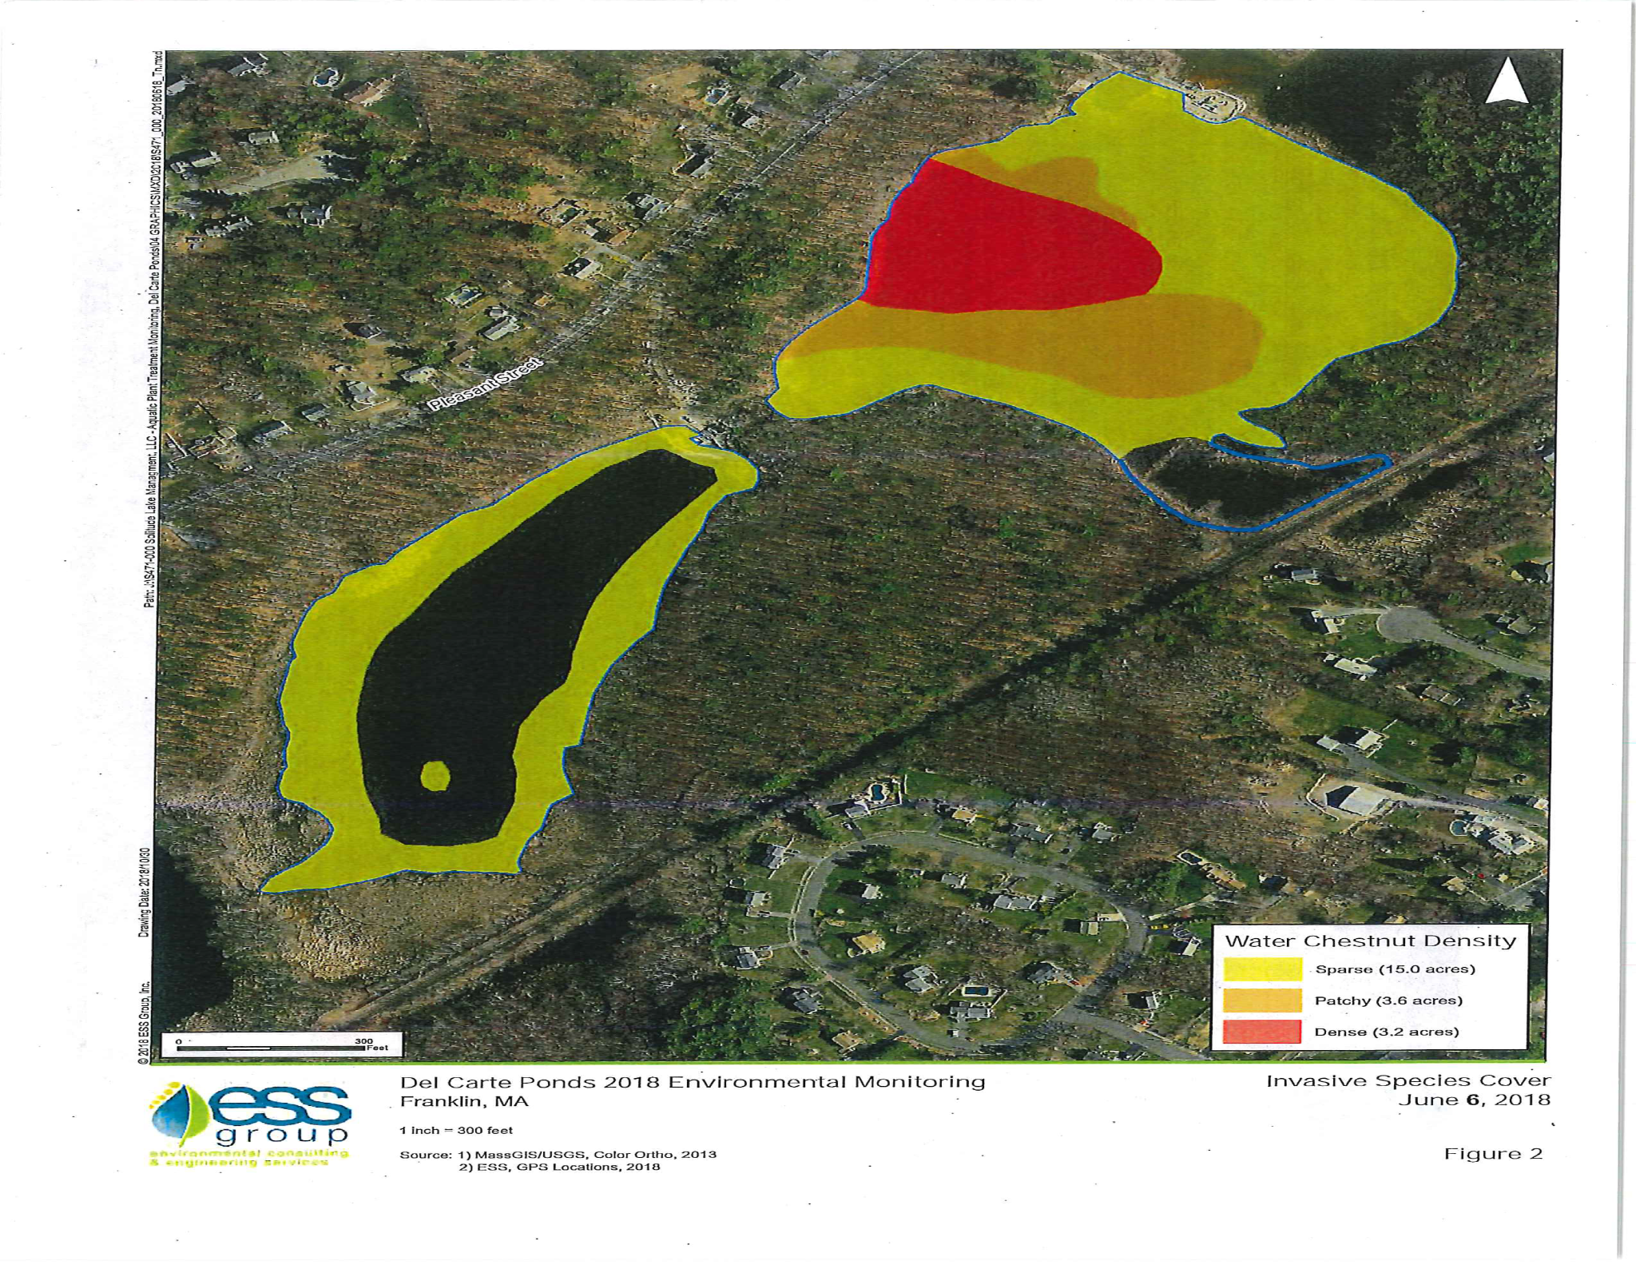
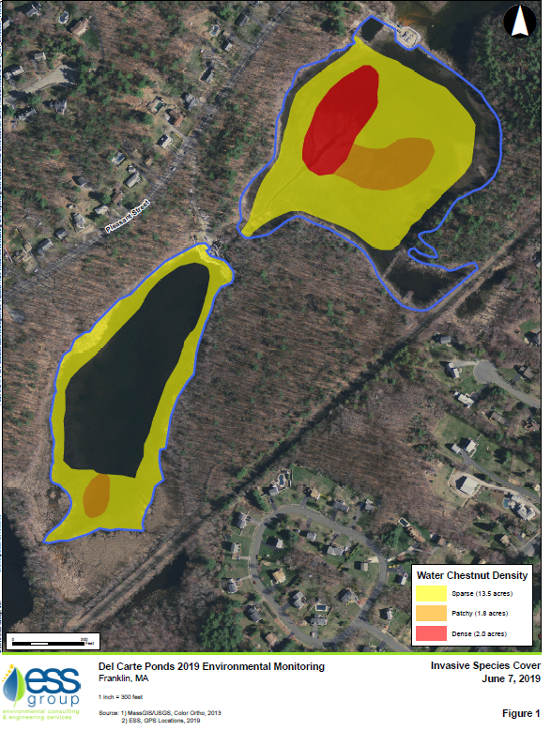
Water Chestnut Comparison: June 2018 vs June 2019
North Basin
Decrease of patchy and dense growth.
Absence of growth on the outer edges.
Sparse = Yellow
Patchy = Orange
Dense = Red

Slide 8
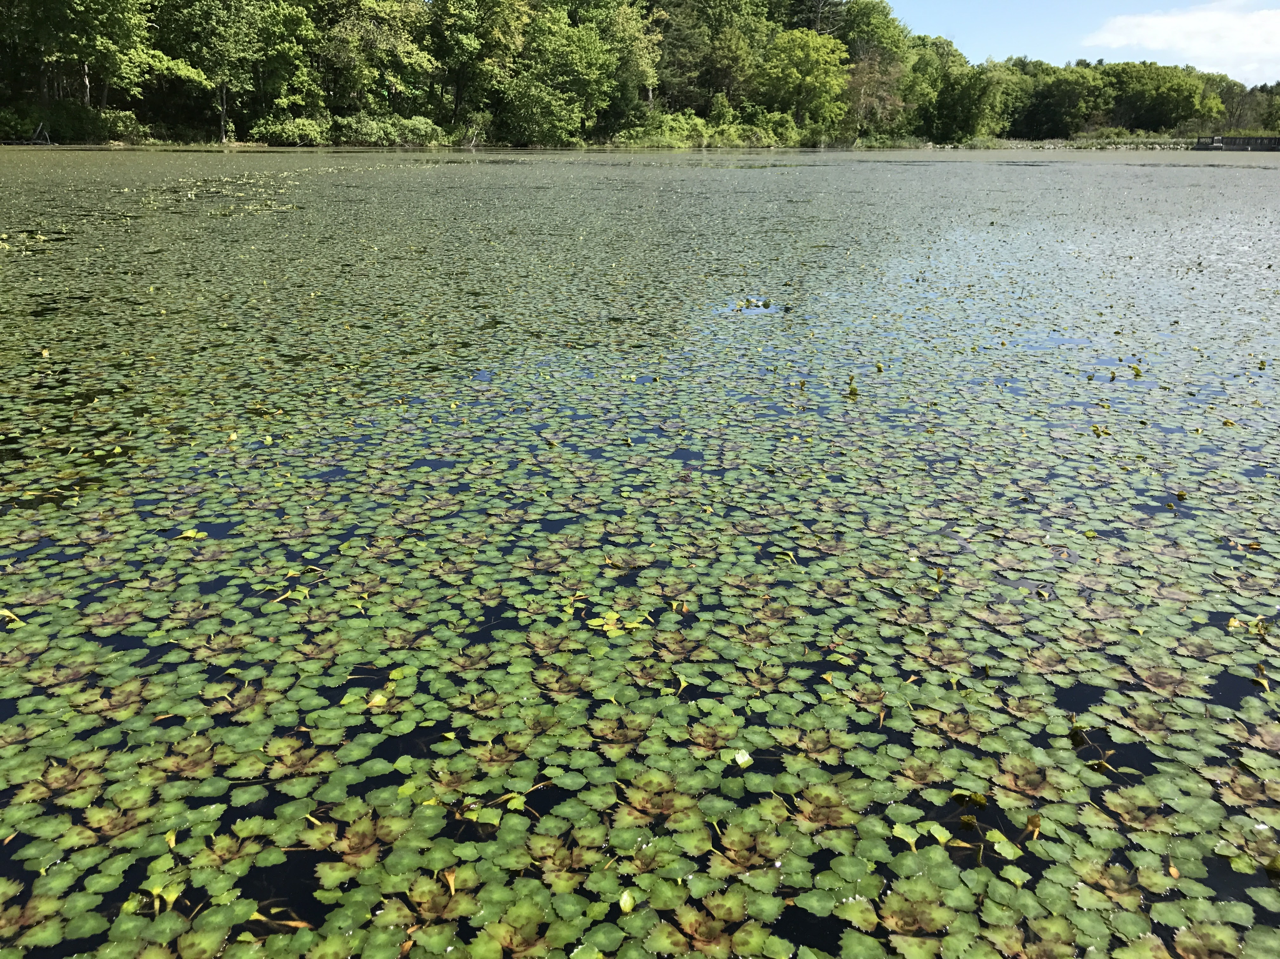
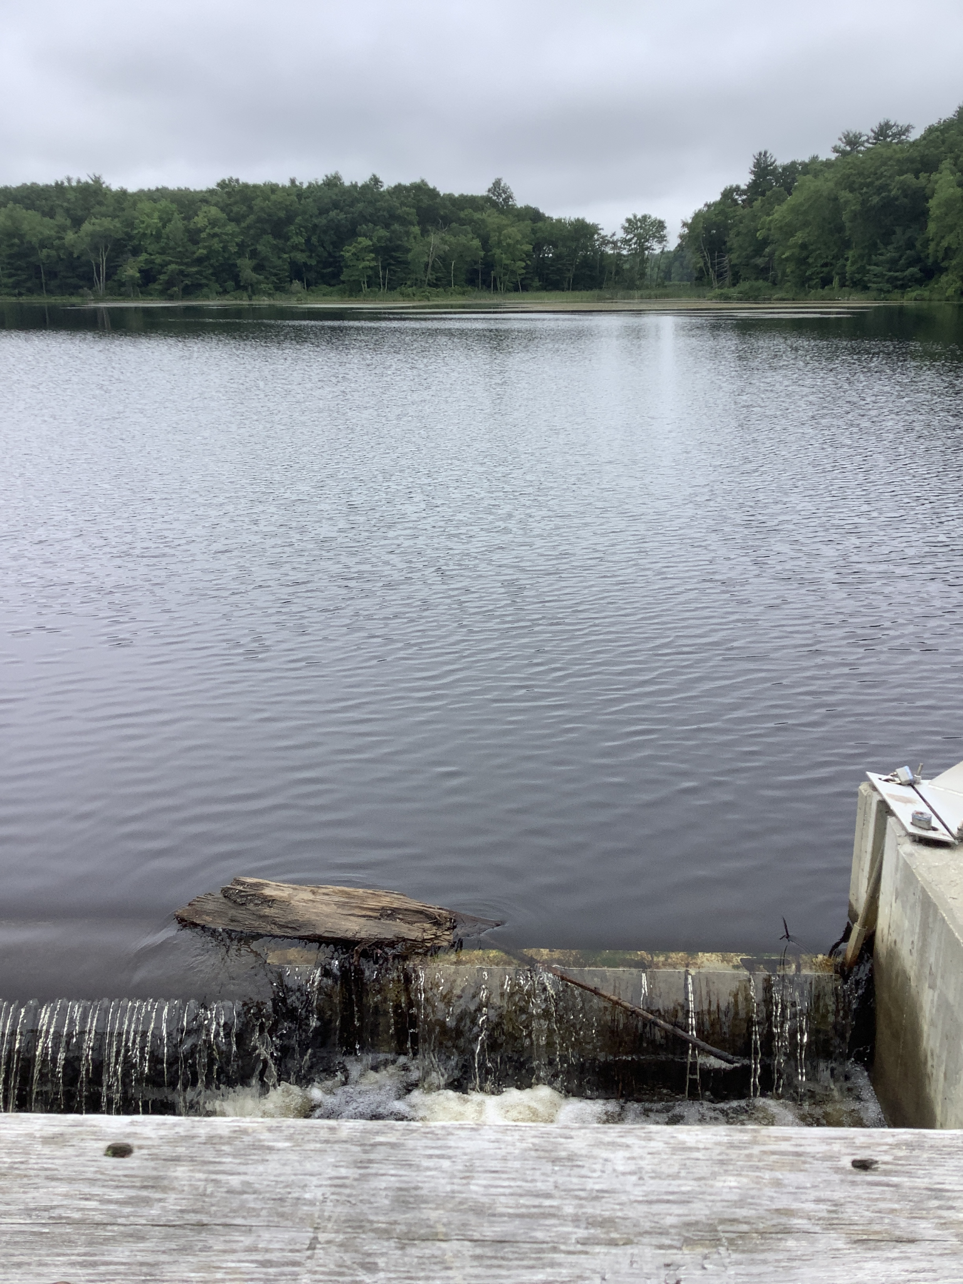
June 2017 vs. July 2021

Slide 9
Variable Milfoil Treatment a Success!
According to discussions with Solitude Lake Management, Milfoil treatments have been successful and the plant was not observed growing in DelCarte ponds in 2020.
However, is was spotted during two of the four 2021 surveys.

Slide 10
Excerpts from 2020 Year End Report
Prepared by ESS Group
Water Chestnut cover in Del Carte Ponds decreased from 21.4 acres in September 2017 to 15.5 acres in September 2020 (decrease of 5.9 acres).
Areas of moderate to dense growth increased from 0.7 acres in 2019 to 3.6 acres in 2020 (increase of 2.9 acres).
These results suggest that management of water chestnut in DelCarte Ponds continues to decrease the overall growth and extent of this species, but that persistent effort is necessary to effectively manage this aggressive invasive species.
Addition of Flumioxazin (Clipper) to aid the uptake of Clearcast expected to help.

Slide 11
Excerpts from 2021 Year End Report
Prepared by ESS Group
Adjusted management approach in 2021
Flumioxazin (Clipper) added to aid the uptake of Clearcast
Water Chestnut cover in Del Carte Ponds decreased again in 2021.
From 21.4 acres in September 2017 to 7.3 acres in September 2021 (decrease of 14.1 acres).
During the same time period areas of moderate to dense growth decreased from 6.0 acres to 2.9 acres (decrease of 3.1 acres).
In comparing 2020 and 2021 end of season surveys, overall water chestnut cover decreased notably from 15.5 acres in 2020 to 7.3 acres in 2021 (decrease of 8.2 acres).
These results suggest that management of water chestnut in DelCarte Ponds continues to decrease the overall growth and extent of this species,
However, continued effort is necessary to effectively manage this aggressive invasive species.

Slide 12
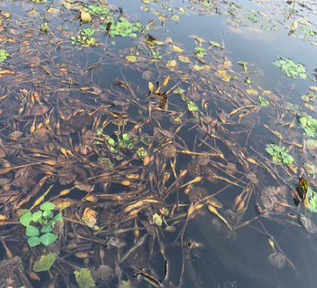
Water chestnut exhibiting die off in the North Basin on September 15, 2021.
Plants were dying and not attached to the pond bottom

Slide 13
Costs of Invasive Species Treatment
Contract for 2017 & 2018 calendar years: $55,900
Contract for 2019, 2020 & 2021 calendar years: $78,750
Total 5 year Total Cost: $134,650
Average Annual Cost: $26,930

Slide 14
Proposed Treatments Recommended for 2022 Calendar Year
Task 1 | Permitting, Notifications, and Posting | $650
Task 2 | Pre & Post Treatment Vegetation Surveys and Water Quality Monitoring | $5,500
Task 3 | Clearcast & Clipper Herbicide Treatments for Water Chestnut Control | $9,850
 | Three separate foliar treatment events, every 2 weeks starting in early June.
 | Multiple watercraft to access targeted growth in shallow areas
Task 4 | Year-End Reporting | $1,750
Total | Estimated Program Cost - $17,750 | $17,750

Slide 15
2022 and Beyond
Recommend going forward with proposed approach.
Recommend using Wetlands Fund to implement proposed approach
Will work with Solitude Lake Management by the end of summer to assess going forward.

