Slide 1
Waterbody Aeration
Franklin conservation Commission
Breeka Li Goodlander, CWS, Conservation Agent
August 4, 2022
“Older ponds can’t retain as much Dissolved Oxygen and often need assistance.” – Solitude Lake Management (SLM)

Slide 2
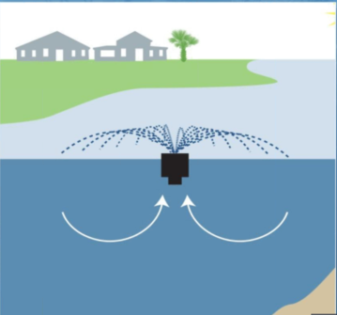
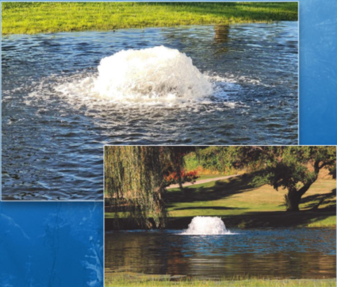
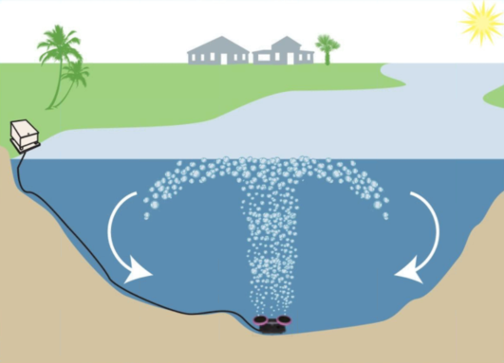
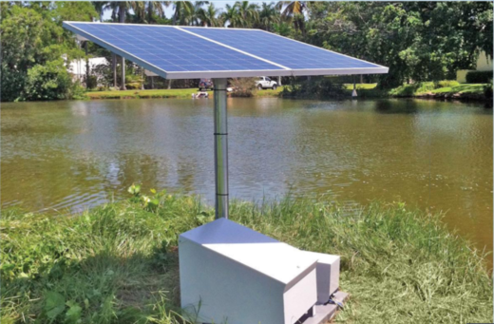
Types of Aerators & their Potential Ecological Benefits (SLM)
Floating fountains (Electric)
Ideal for shallow waterbodies, depths above 4 to 6 feet
Increases dissolved oxygen (DO) levels in the top layer of the pond
Helps prevent stagnant water
Surface aerators (Electric)
Ideal for shallow waterbodies, depths above 4 to 6 feet
Increases DO levels throughout the water column
Moves more water volume than fountains
1 liter floating aerator moves 380 gallons/minute
1 liter surface aerator moves 1,000 gallons/minute
Helps prevent stagnant water
Circulates the water column without bottom turbulence
Submersed aerators (Electric)
Ideal for deeper waterbodies, depths more than 4 to 6 feet
Increases DO level throughout the waterbody via vertical mixing
Increases water clarity
Helps reduce the accumulation of bottom sediment (Natural to a point– BG)
Helps prevent water from freezing in the winter (Natural– BG)
Can be customized based on waterbody size
Solar aeration solutions

Slide 3
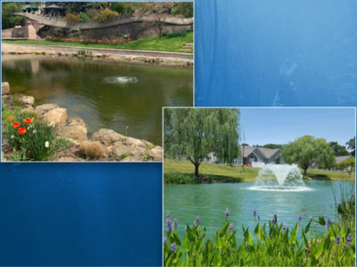
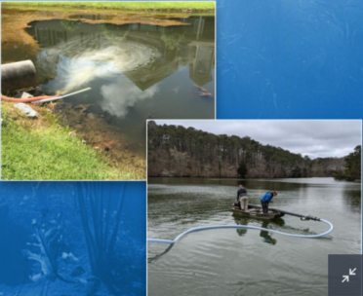
Circulation versus Oxygenation Systems (SLM)
Moving water versus introducing oxygen
Circulation = fountains, surface aerators, and submersed aerators
Oxygenation = nanobubbles, direct oxygenation
“The system type depends on size, depth, shape, goals, and budget.” – Solitude Lake Management (SLM)

Slide 4
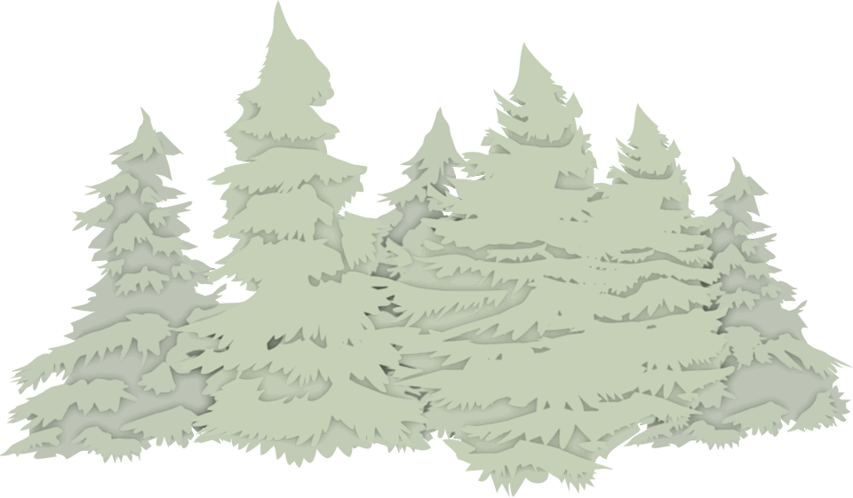
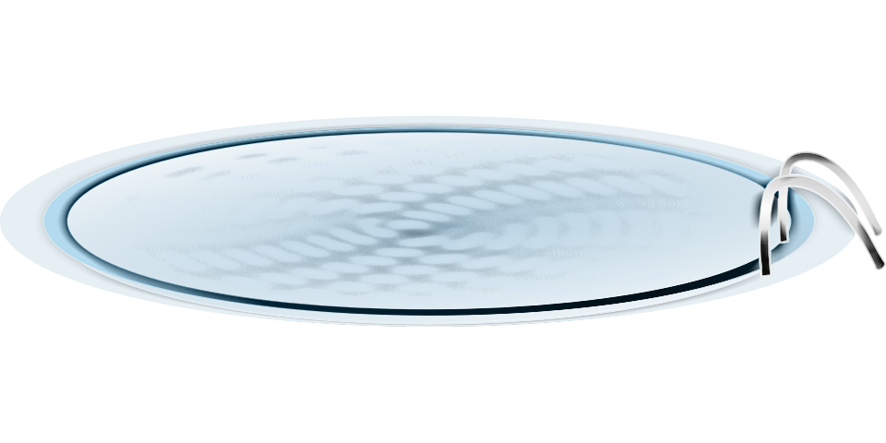
Applicable Ecological Benefits?
DelCarte – Probably not…
Already being treated; high movement of water; DO is on par per SLM
“If it’s not broken, don’t fix it”; functioning natural ecosystem
Too much aeration can lower DO > hyperactive (stressed, tired) fish > higher spread of diseases and parasites
Small amount of gas in your fuel tank
Gas has to be maintained a certain level otherwise you will not be able to put the cap back on the tank. Similar to oxygen in water. Too much oxygen can get trapped under the water’s surface and cause suffocation. (Need free movement)
“Anoxia”; wetlands are anaerobic ecosystems
Vegetation - root damage, yellow and blackened leaves due to oxygen depletion caused by excessive aeration
Sculpture Garden – Likely…
Aeration can aid decomposition of plant material, decaying debris > less toxins released (natural process) > less algae growth
Usually ponds that have high amounts of algae, high heat, and wind exposure are not properly aerated
Eutrophication; altered
Other areas?

